Slide 1
FLIGHT BOOKING SYSTEM
We are here to make your flight booking experience hastle free ☺
24-BCA-165 Devanshi Koshti
24-BCA-179 Krish Parmar
24-BCA-195 Richa Tekwani

Slide 2
INTRODUCTION
The Flight Booking System is a comprehensive Java-based application designed to simplify and automate the process of flight ticket reservations. It provides a user-friendly interface for customers to:
- ✈Search for available flights based on origin and destination
- 🎫 Book tickets for multiple passengers
- 💺 Select preferred seats from available options
- 💳 Make payments through various methods
- 📋 Manage bookings (view, update, cancel)

Slide 3
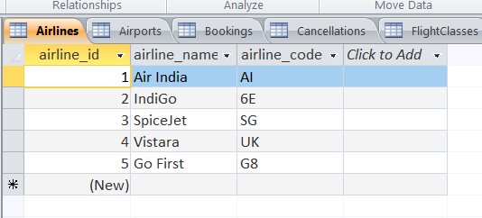
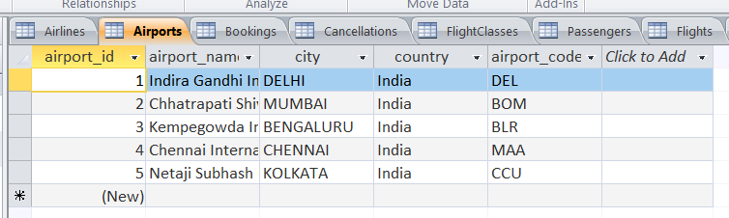
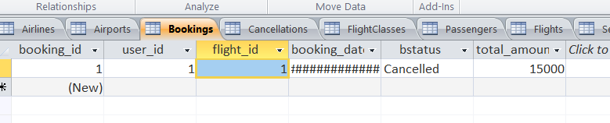
DATABASE- Design View of Tables

Slide 4
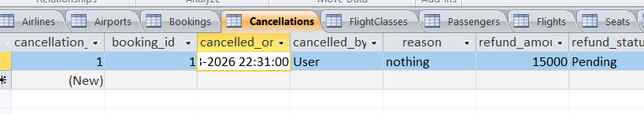
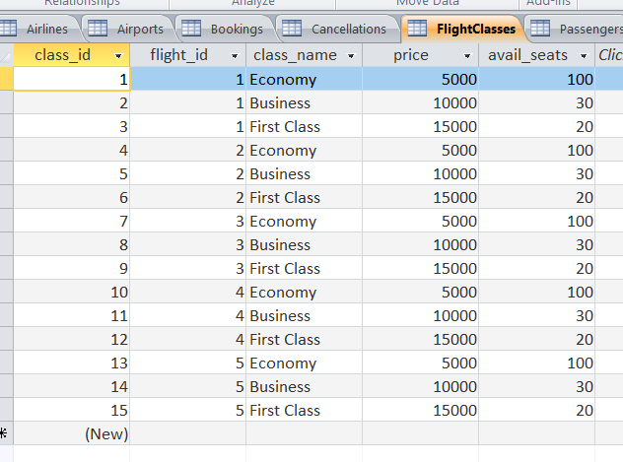

Slide 5
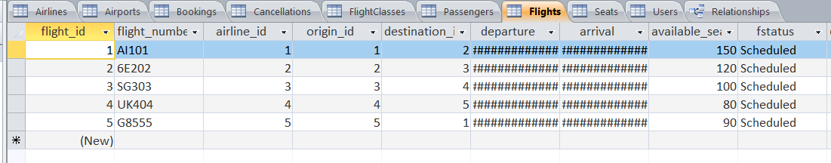
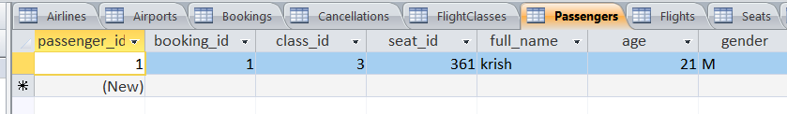
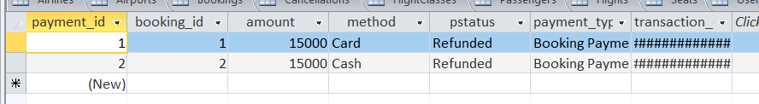

Slide 6
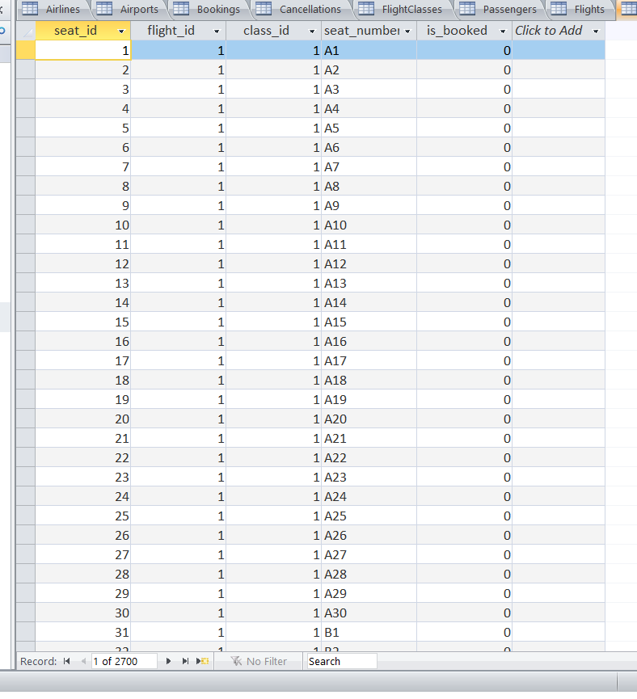
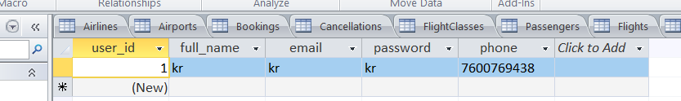

Slide 7
ENTITY RELATIONSHIP DIAGRAM

Slide 8
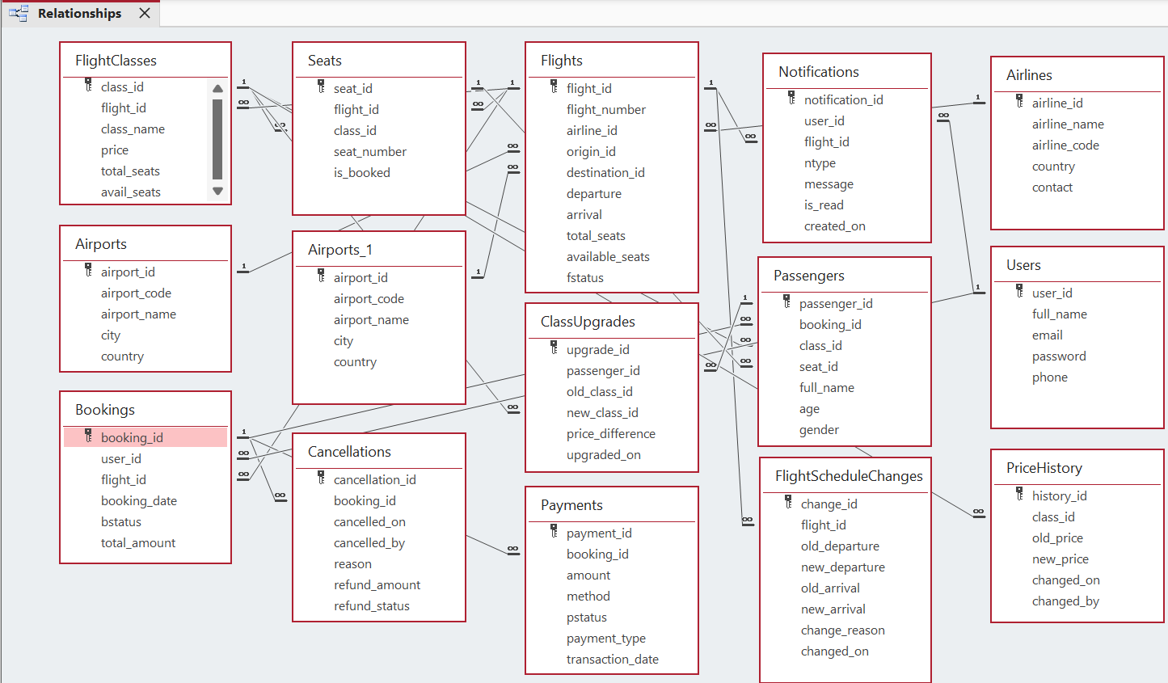

Slide 9
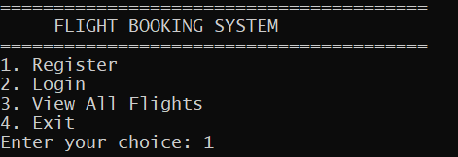
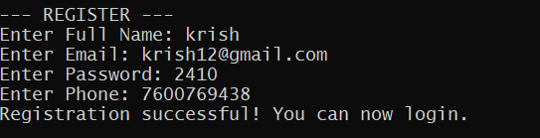
SCREENSHOTS OF THE SYSTEM

Slide 10
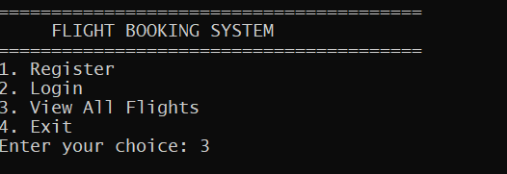
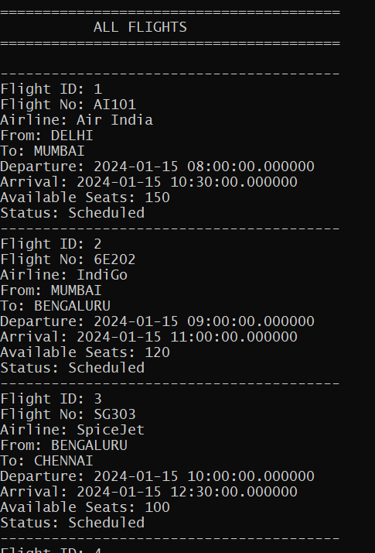
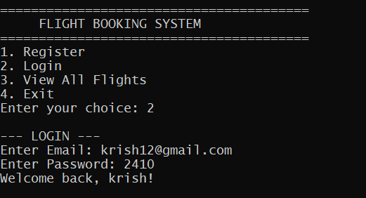

Slide 11
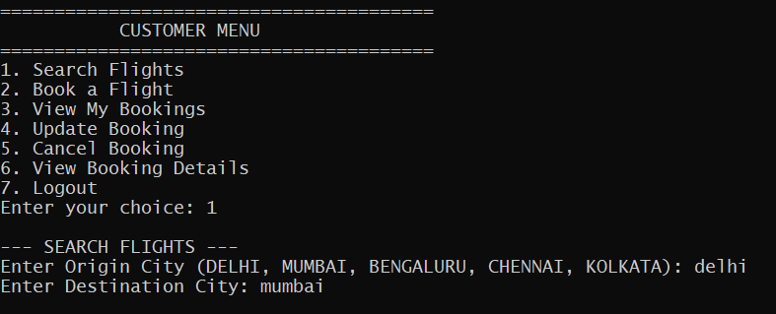
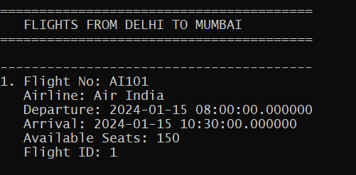

Slide 12
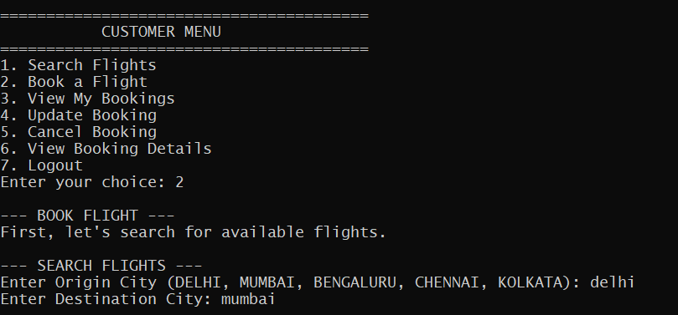
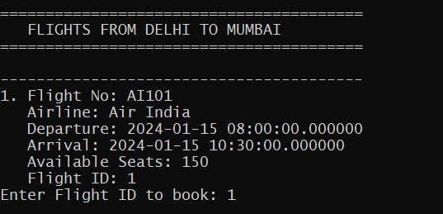

Slide 13
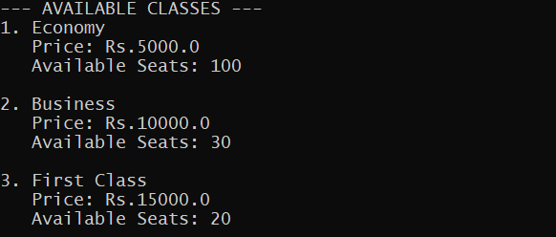
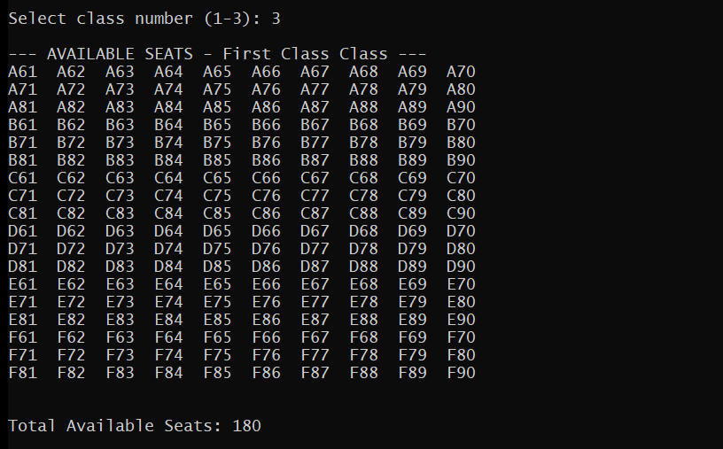

Slide 14
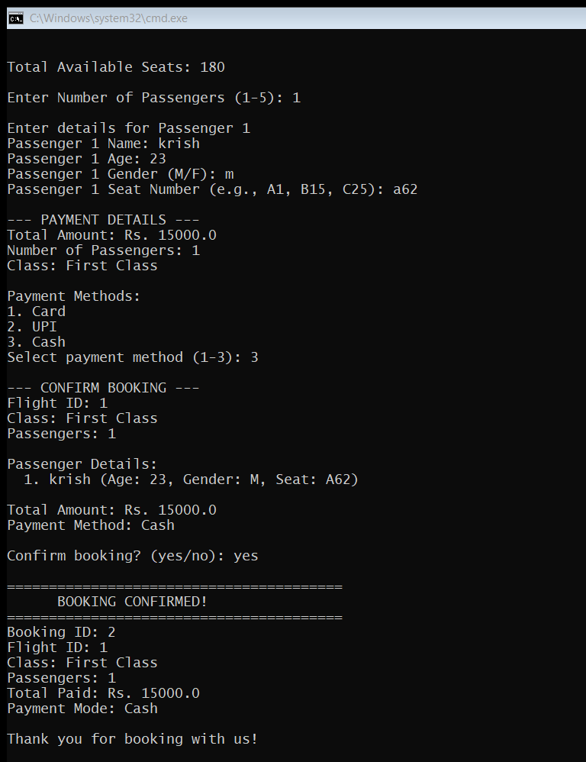

Slide 15
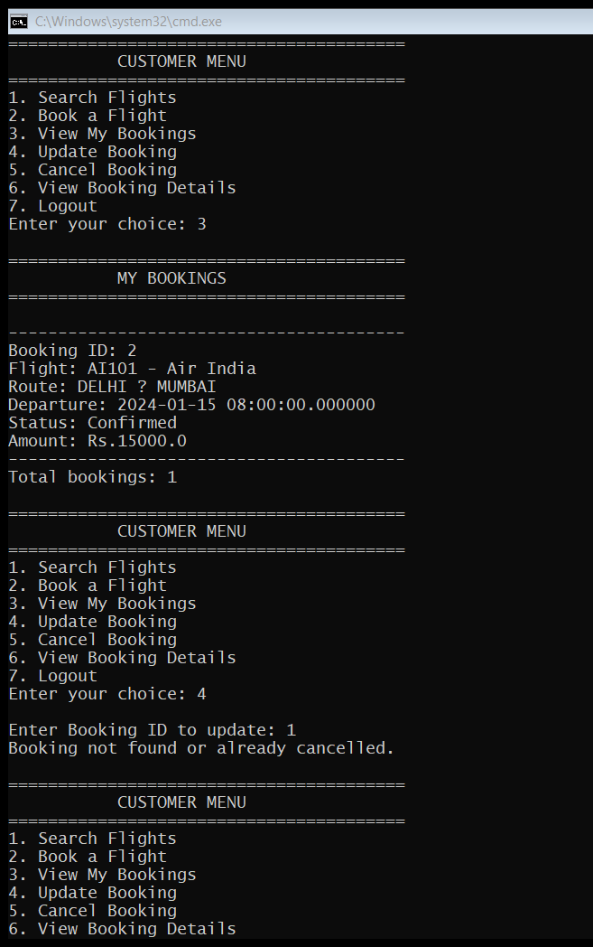

Slide 16
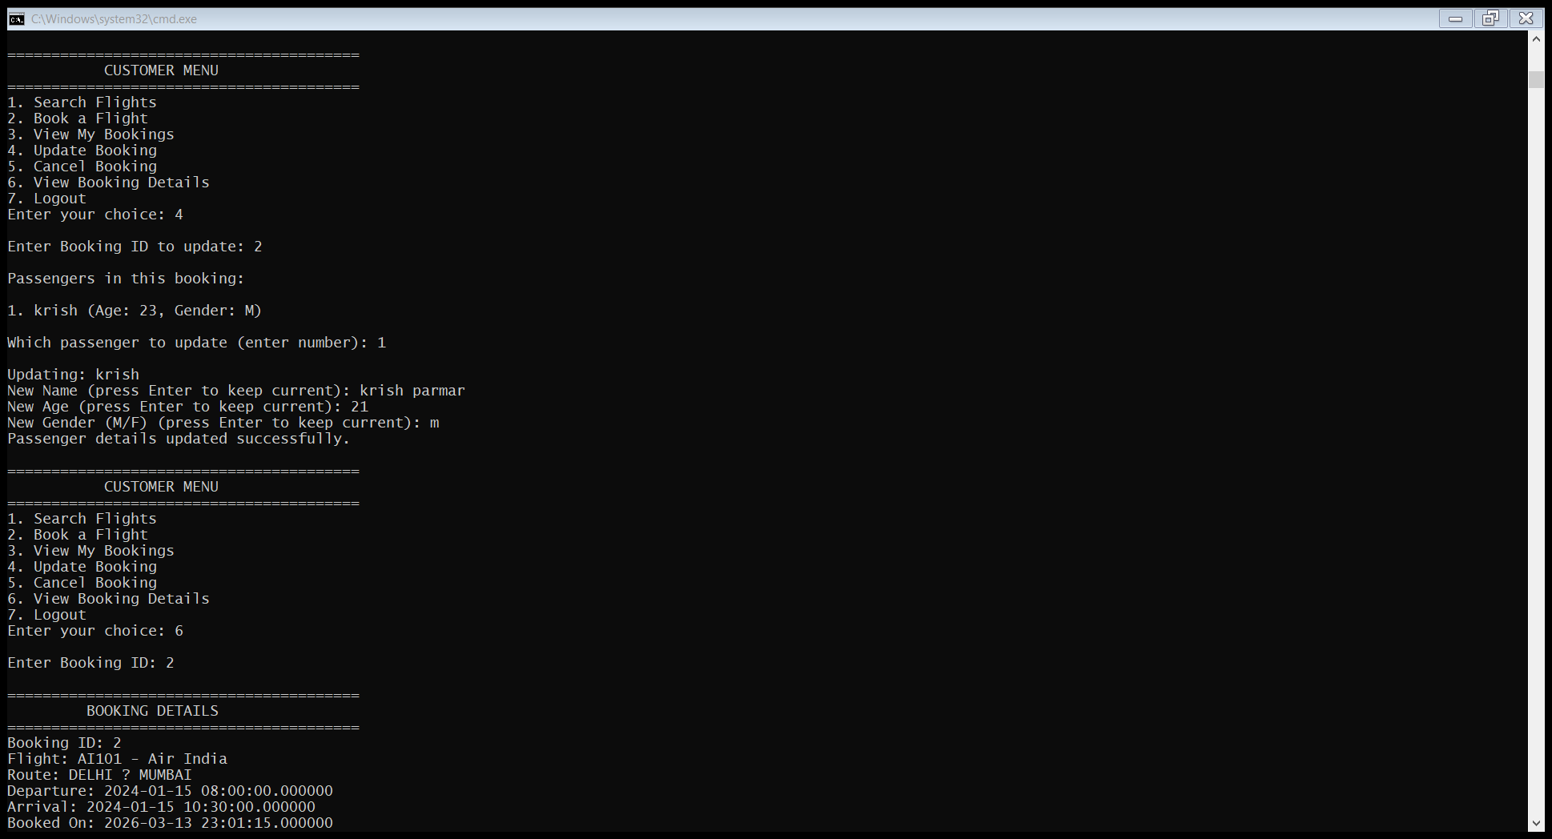

Slide 17
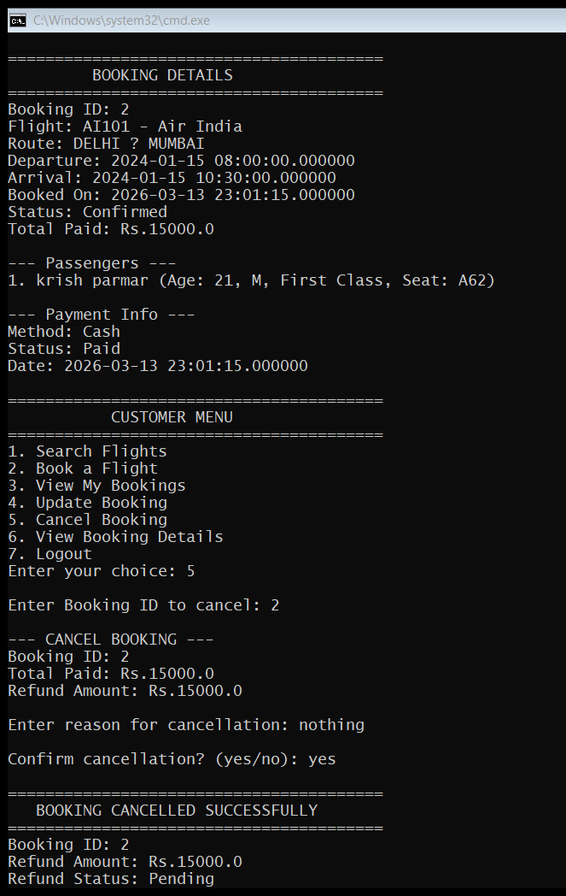

Slide 18
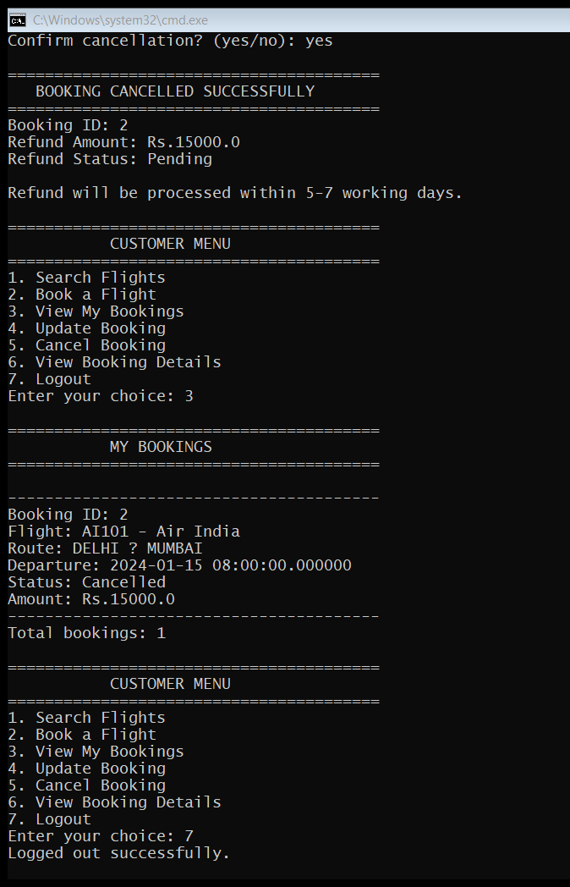

Slide 19
THANK YOU

